Slide 1
Mapping in python to match mapping idl

Slide 2
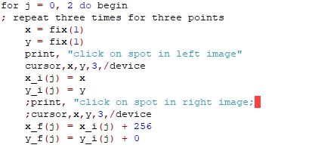

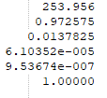
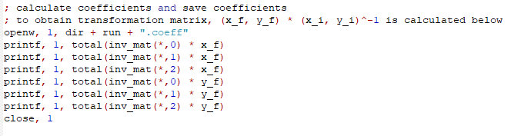
IDL generates .coeff in 2c, use it in 2n
Coeff is a rough transformation based on three manually clicked points.
Coeff takes into account only 0th and 1st polynomials of x,y
Example content of .coeff:

Slide 3
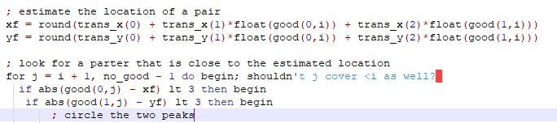
In 2n
xy-positions of spots in left image are converted to estimated xy-pos in right image
A closeby partnering spot is found, xy-position is fine-tuned.
With many spots P,Q are calculated (higher polynomial transform coeff)

Slide 4
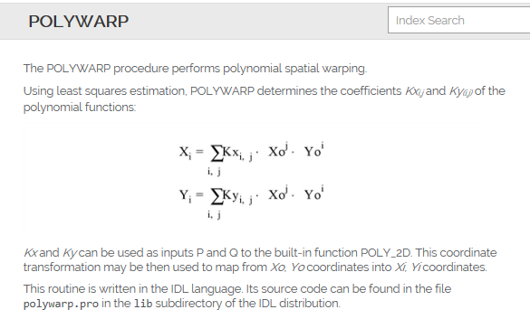
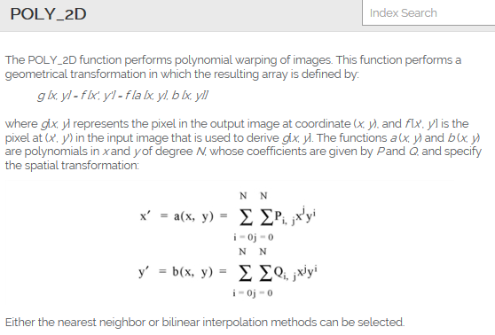
IDL generates.map in 2n, use it in ffp
Apply P,Q: poly_2D(im,P,Q,2)
Generate P,Q with polywarp
Map is automatically generated, and takes into account >>>3 points
Map takes 0-3 polynomials into account

Slide 5
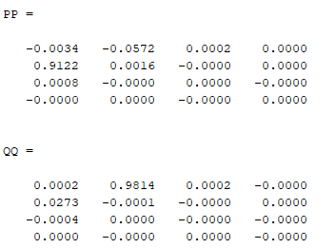
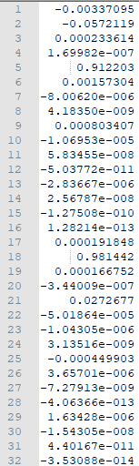
Comparison .map and .coeff
coeff:
Map of same data:
(notice only lower polynomials are contributing)

Slide 6
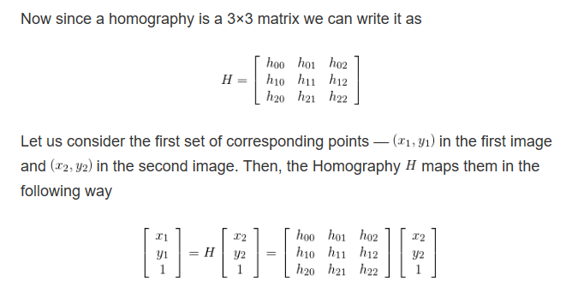
Mapping in python, only lower polynomials

Slide 7
Mapping in python, different procedure
Fully automatic: works on tetraspeck images, better result than manual
Manual clicking (for single molecule images):
click 10 spots in the green channel
in a loop over the spots, adjust the position of the spot in red channel
Again transformation matrix is produced, with less points than fully automated.
The data is stored in similar way ( in P=4x4 array, of which only P₀₀, P₀₁ and P₁₀ have a certain value)

Slide 8
Make Python produce same .map & .coeff
x_new=h00 x + h01 y + h02= P10 x¹y⁰ + P01 x⁰y¹ + P00 x⁰y⁰
y_new=h10 x + h11 y + h12= Q10 x¹y⁰ + Q01 x⁰y¹ + Q00 x⁰y⁰
1=h20 x + h20 y + h22 => h20=h21=0, h22=1
So transform matrix (Python) should be:
[ P10 P01 P00;
Q10 Q01 Q00;
0 0 1 ]

Slide 9

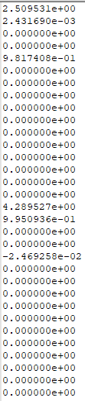
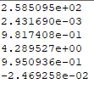
Simple transformations are dominant
Python:
Stored as .map stored as .coeff

